Slide 1
Animals-10
Deep Learning Project Report

Slide 2
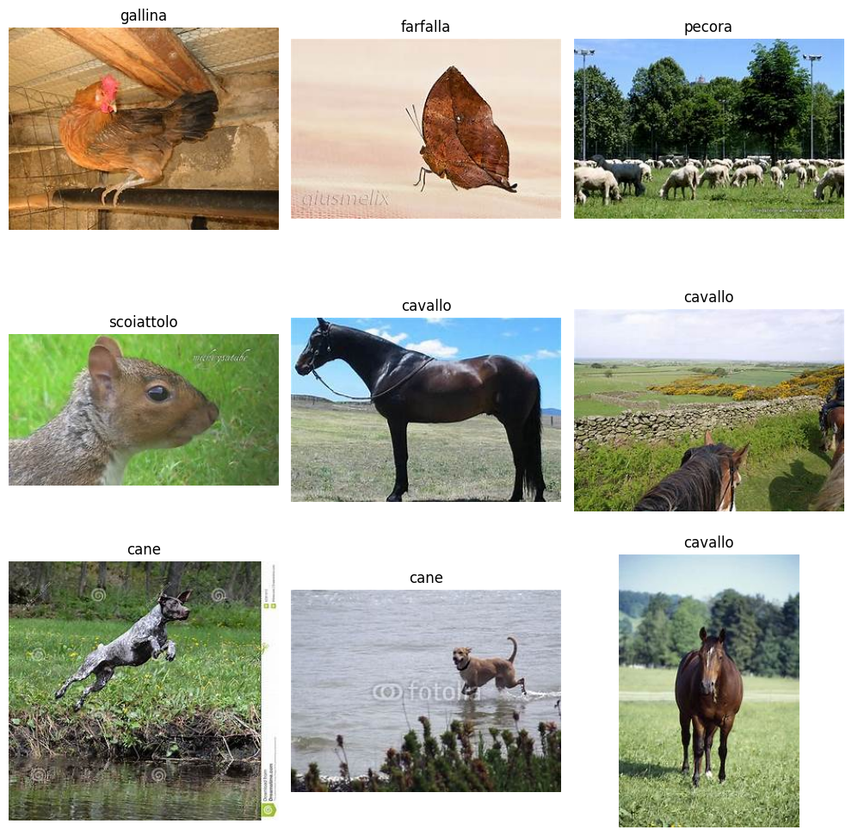
We you get when you mix 28k animal pictures, some Python code, and a ton of curiosity?
An AI that can spot the difference between a butterfly and a chicken.
We challenged ourselves to build a deep learning model that sees the world like we do.

Slide 3
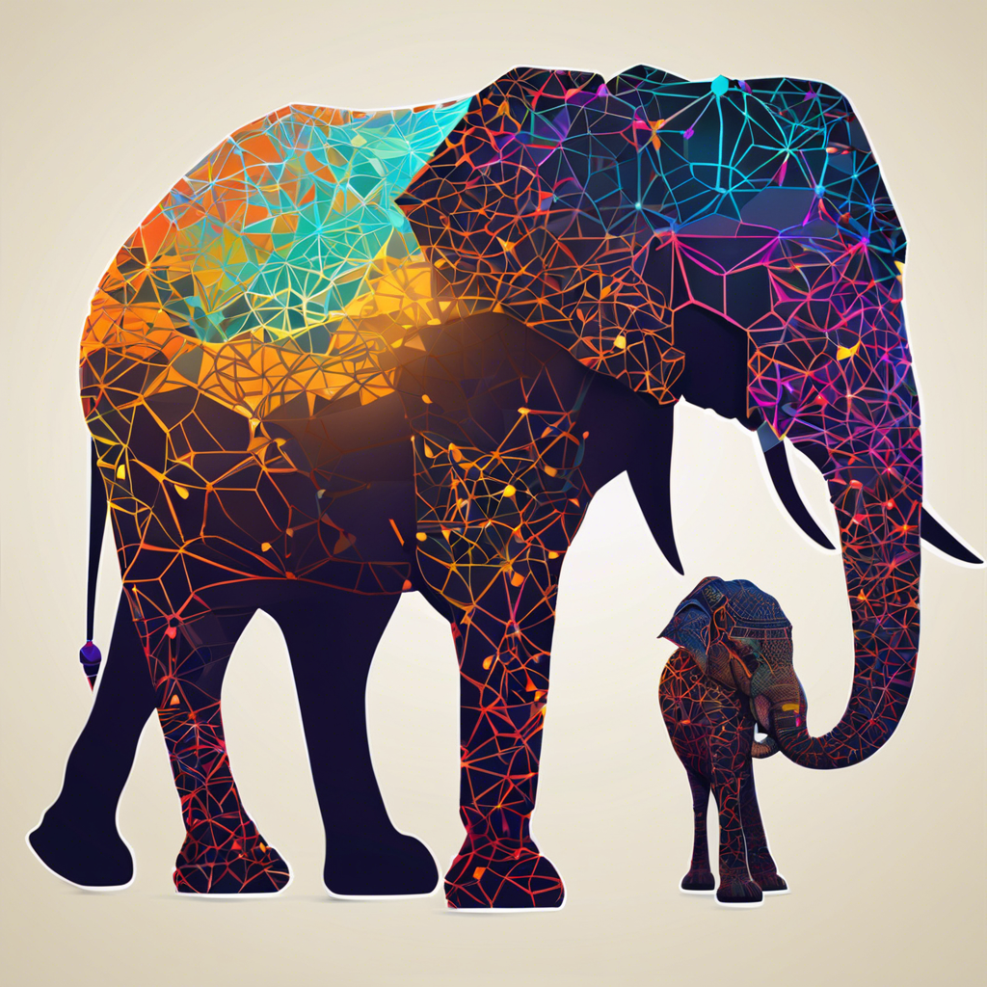
Dataset Chosen
Chosen dataset: Animals-10
Number of classes: 10
Number of images: ~28,000
Image dimensions: Varying, resized to 128x128

Slide 4
Overview of the Problem
Image classification
Custom CNNs
Transfer Learning

Slide 5

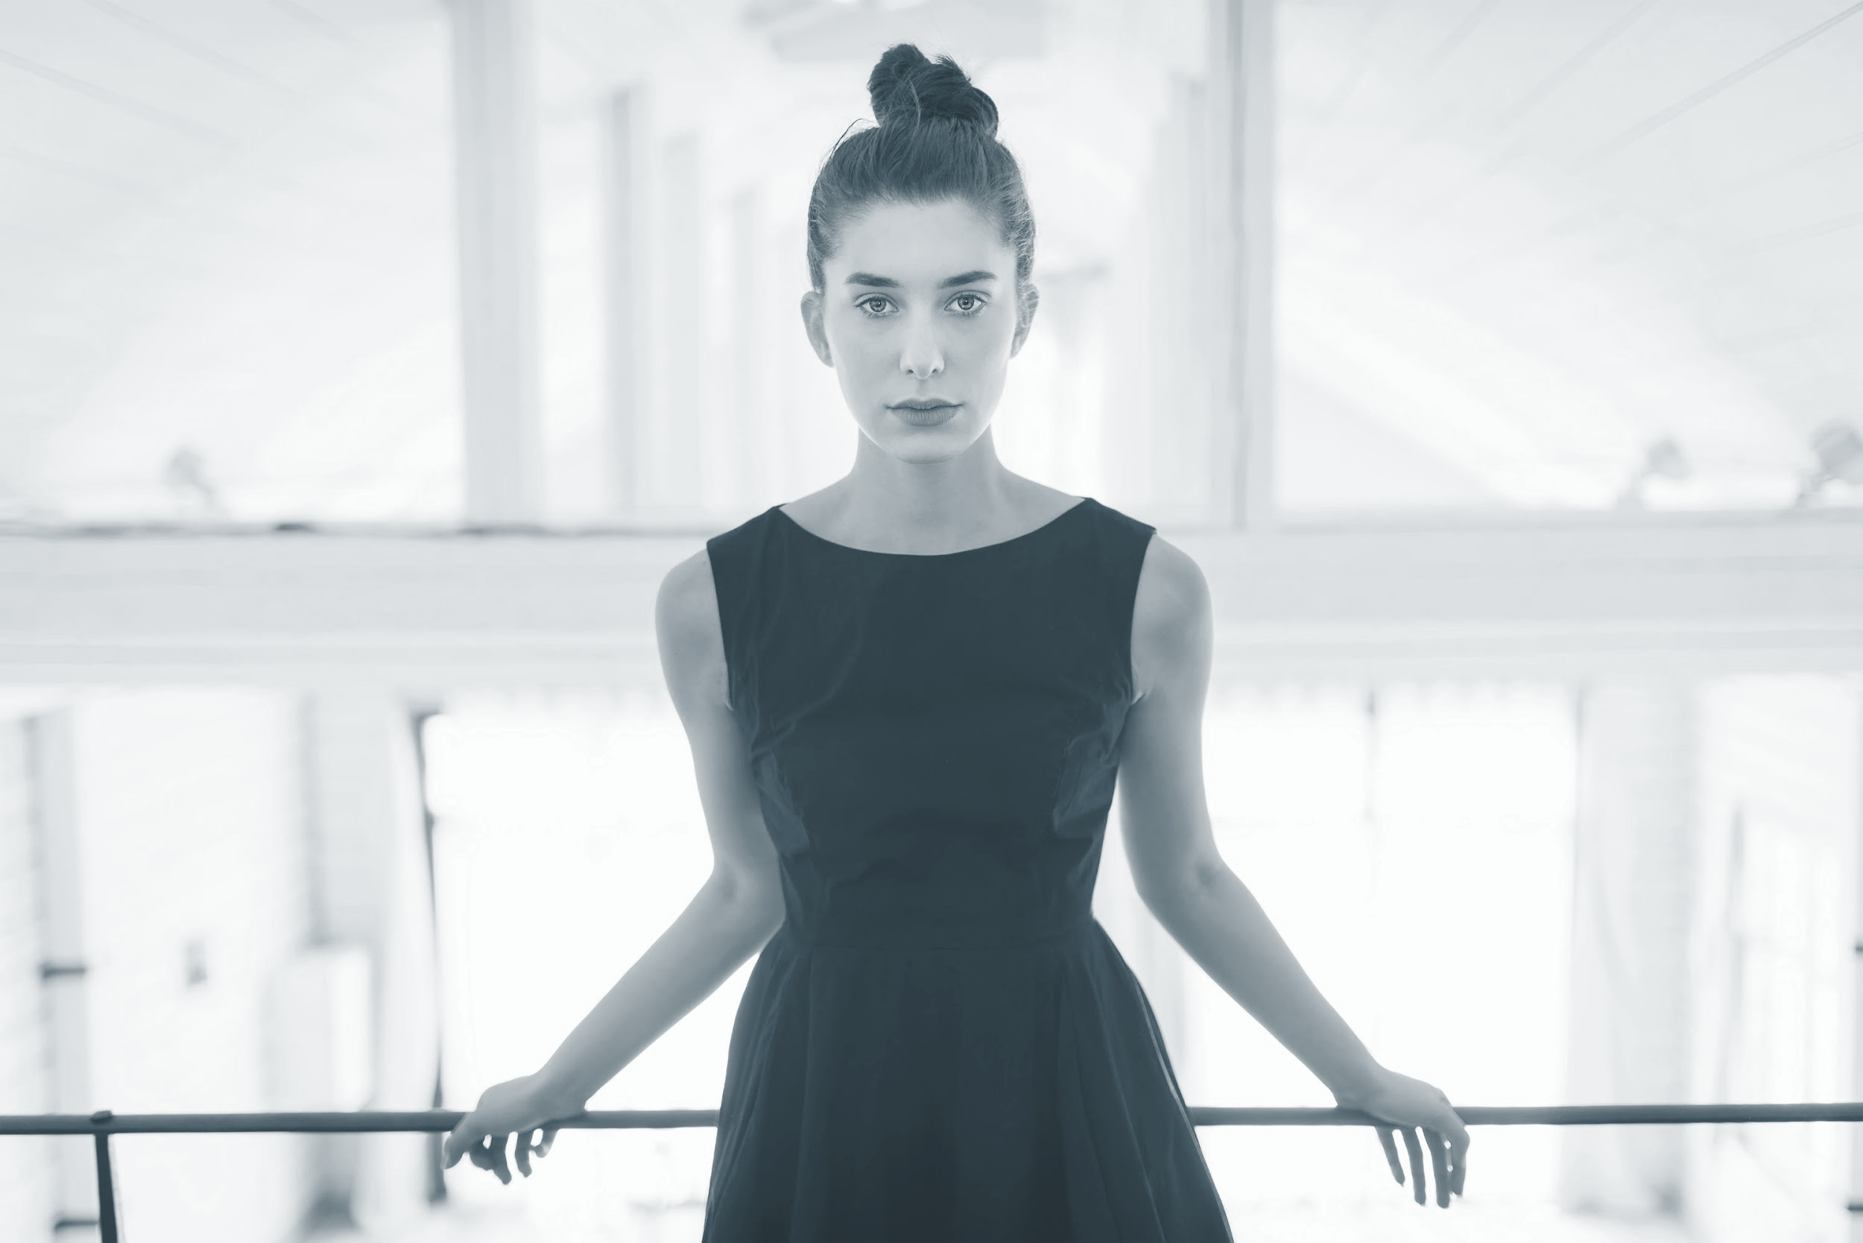
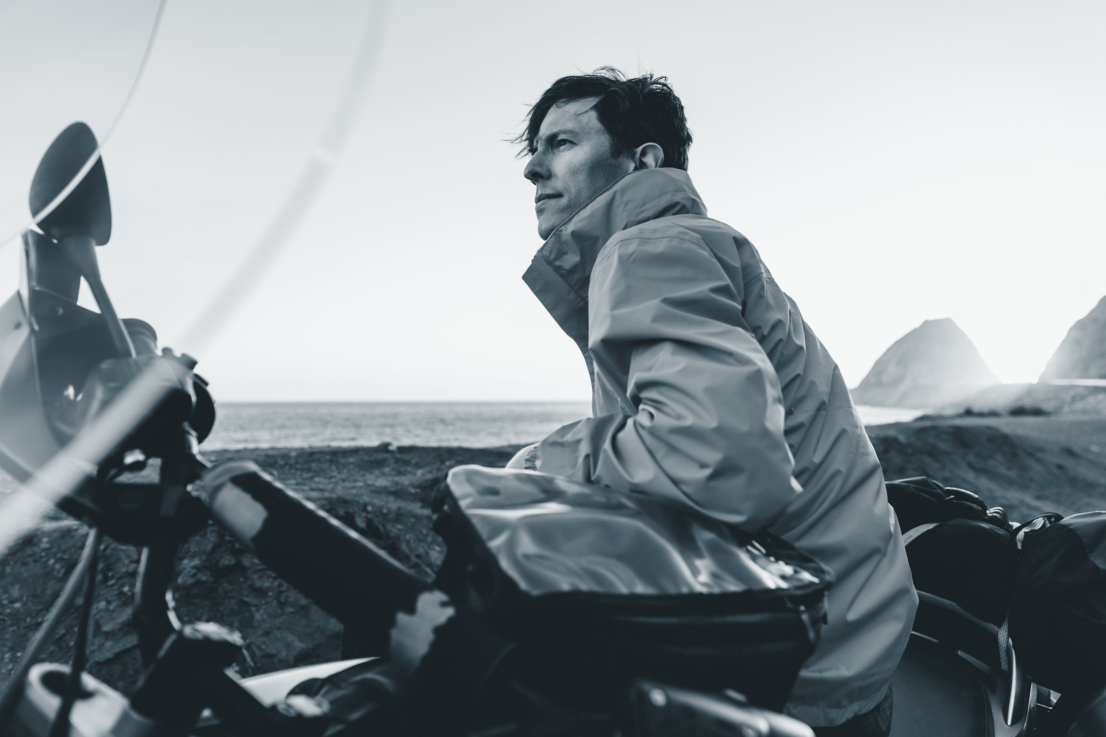
Data Pre-processing
Data Cleaning
Data Augmentation
Normalization / Standardization

Slide 6
Data Pre-processing
Workflow Diagram
Sample Images
Statistics

Slide 7
Designed CNN Architecture
• Use diagrams to illustrate the CNN architecture
Affiong

Slide 8
Designed CNN Architecture
• Use diagrams to illustrate the CNN architecture

Slide 9
Details on the optimization techniques used
Used Adam optimizer for adaptive learning
Applied CrossEntropyLoss for multi-class classification
Implemented early stopping to avoid overfitting
Used a learning rate scheduler to improve convergence
Added Dropout (0.3) for regularization
Included Batch Normalization for stable training

Slide 10
Transfer Learning
Used ResNet50 pretrained on ImageNet
Why ResNet50?
Deep architecture with residual connections
Robust for image classification tasks
Modifications:
Removed top layers (no include_top)
Added:
GlobalAveragePooling2D()
Dense(128, ReLU)
Dropout(0.3)
Dense(10, softmax) for 10 animal classes
ResNet base frozen during initial training

Slide 11
Transfer Learning
Luis

Slide 12
Evaluation
Train/Validation split used for performance tracking
Evaluated on validation set using:
Accuracy
Precision
Recall
F1-score
Confusion matrix to visualize class-level performance
Selected best model based on overall validation accuracy

Slide 13
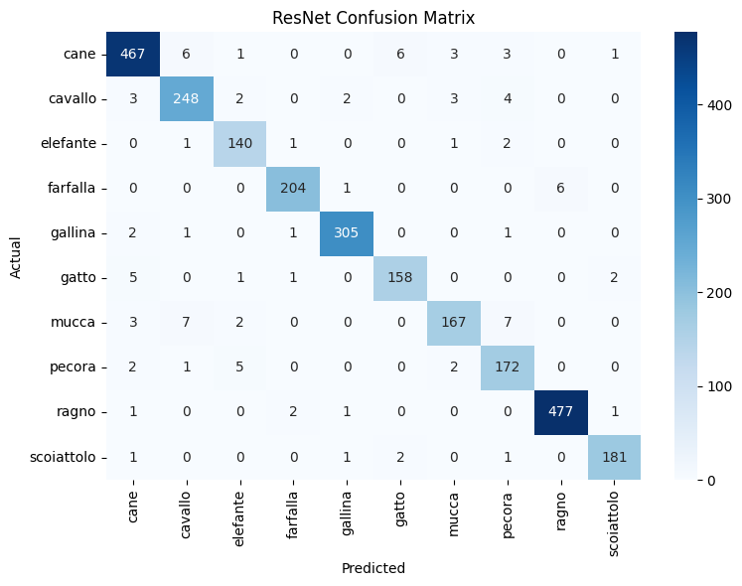
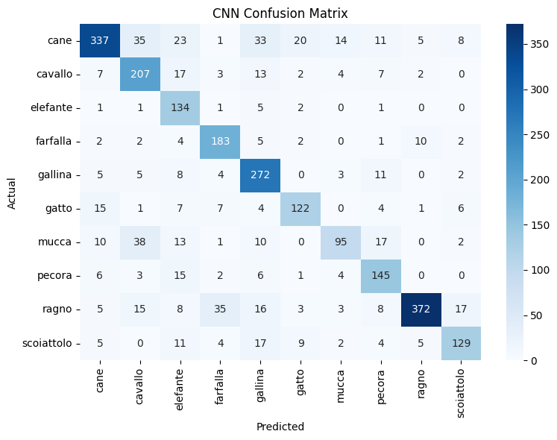
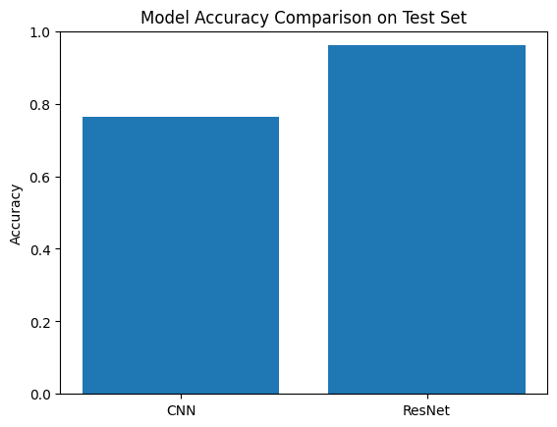
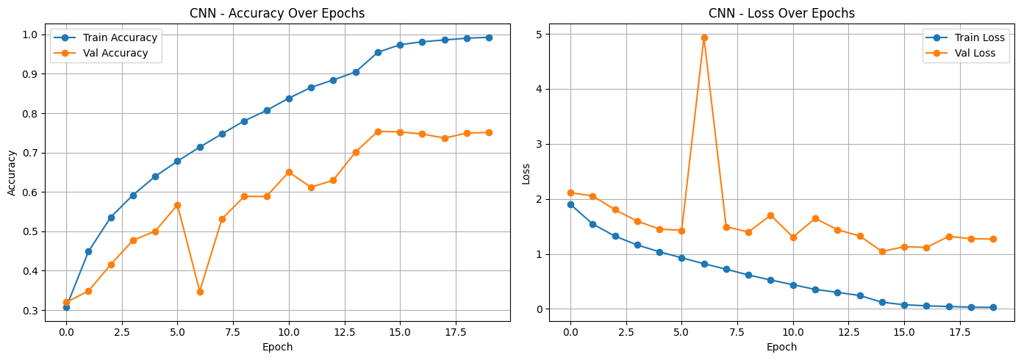
Evaluation
Include metrics, confusion matrix and plots for both CNN and transfer learning

Slide 14
Model deployment
Optional, as model deployment is a bonus question
Luis

Slide 15
Overview of the Project / Recap
Goal: Build a deep learning model to classify animal images into 10 categories using the Animals-10 dataset.
Model:
Based on CNN architecture
Leveraged transfer learning with models like ResNet50
Fine-tuned on augmented training data
Outcome:
Successfully trained a model to classify animal species with high accuracy.
Demonstrated the effectiveness of preprocessing and augmentation.

Slide 16
Thank you
Project 2: Deep Learning
Group 1:
Luis
Affiong
Nicholai

